Slide 1
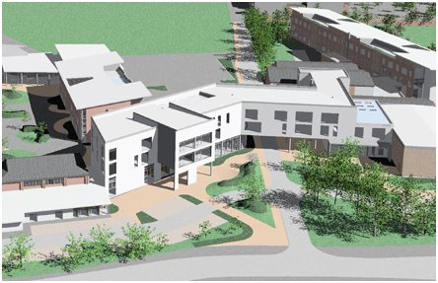










Slide 2




Slide 3
What is Social Mobility?
Provide greater access to opportunities
Support students from areas where progress into HE are low in relation to the rest of the country
“Level up” the playing field for students

Slide 4
What programmes do we offer?
Social Mobility Foundation (Applications open. Assembly 3rd Oct Closes December)
Liverpool Scholars (Assembly TBC. Closes November)
The Sutton Trust (Applications open. Closes end of October)
Arts Emergency (Applications open. Closes September 30th)
Aspire (Applications open. Apply to Mr Phipps)

Slide 5



Slide 6
Eligibility Criteria
Currently in Year 12
Achieved 4 or 5 Grade 7s at GCSE
Predicted ABB at A Level or equivalent
Eligible for free school meals OR first generation to attend university

Slide 7

Take part in a range of activities aimed at supporting entry into higher education
Application guidance masterclasses, lectures and academic key skills workshops.
Culminating in Scholars completing an academic assignment.
Benefits:
A guaranteed conditional offer of a place at the University of Liverpool*
An offer reduced by up to 2 A Level grades or equivalent
Scholars students applying to Medicine, Dentistry and Veterinary Science at the University of Liverpool may not be required to meet the strict GCSE entry requirements outlined in the University's guidelines
On completion of the Scholars programme you get the Liverpool Scholars Award (a non-repayable financial bursary to help towards tuition fees and living costs if you study at Uni of Liverpool.)

Slide 8
Eligibility Criteria
Step one:
In order to be eligible to apply for the Liverpool Scholars Programme students must meet all of the following criteria:
Have achieved at least five grade 9 – 6 at GCSE (or equivalent, eg BTEC certificate); if this does not include English Language and Mathematics you must have achieved at least a grade 4 in these subjects
Step two:
Students must also meet at least two of the following criteria:
Live in a neighbourhood which has a low progression rate to higher education or an area which has a high level of financial, social or economic deprivation. This is defined by home postcode
Come from a home where neither parent attended university in the UK or abroad.
Be in receipt of or entitled to discretionary payments/16-19 bursary/Pupil Premium
Be in receipt of or entitled to free school meals, or have been entitled to them at a point in the last six years

Slide 9


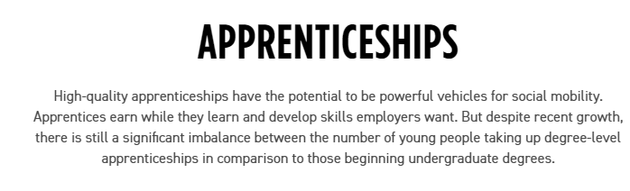

Slide 10
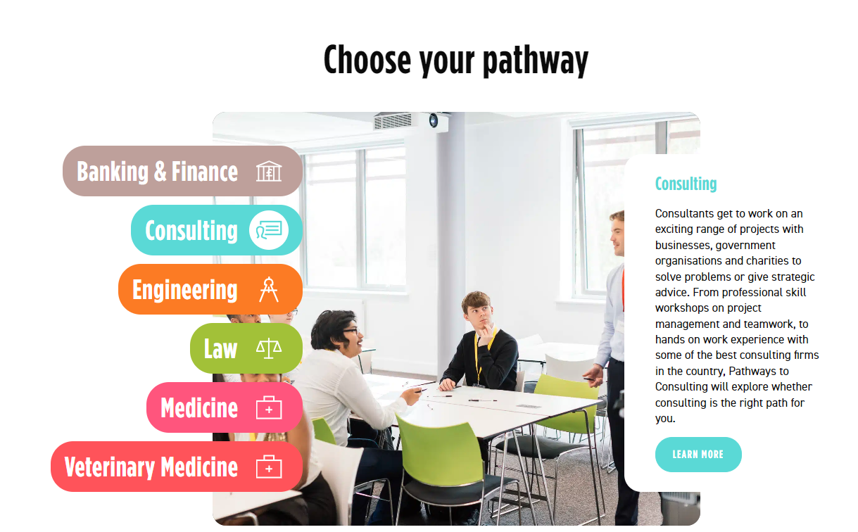

Slide 11

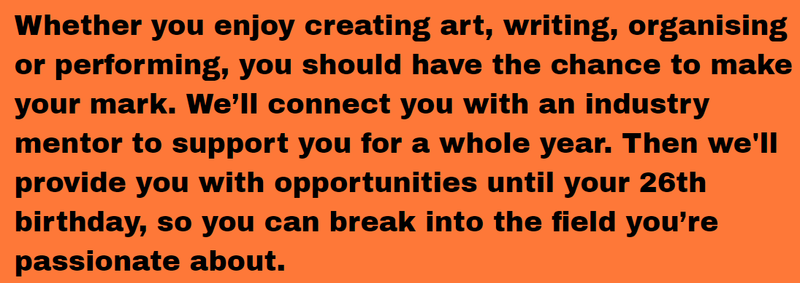
Click here for video

Slide 12
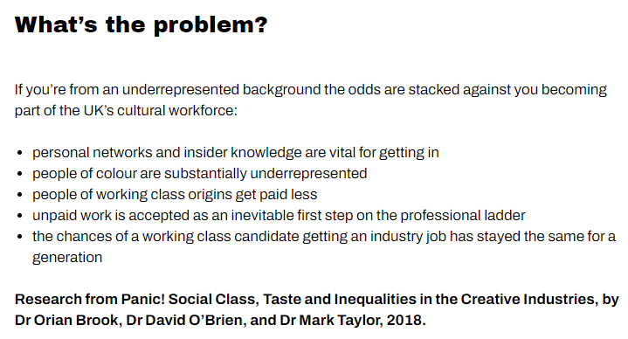

Slide 13
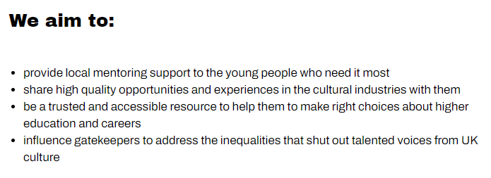

Slide 14
Who can apply?
We try to work with young people who most need the support of an Arts Emergency mentor, and therefore every mentee must tick at least one of the criteria below:
Neither of my parents went to university
My family’s household income is below £25,000 per year
Me or my family receive Universal Credit
I am currently in care
I have previously been in care
I am currently eligible for Free School Meals
I was eligible for Free School Meals between year 7 and year 11
I was or am a recipient of a 16-19 bursary
I am a refugee or asylum seeker
I would describe myself as Black, Asian or from an ethnic minority background
I have a disability*
I have a learning disability and/or I have special educational needs*
I am a young parent
I am a young carer

Slide 15
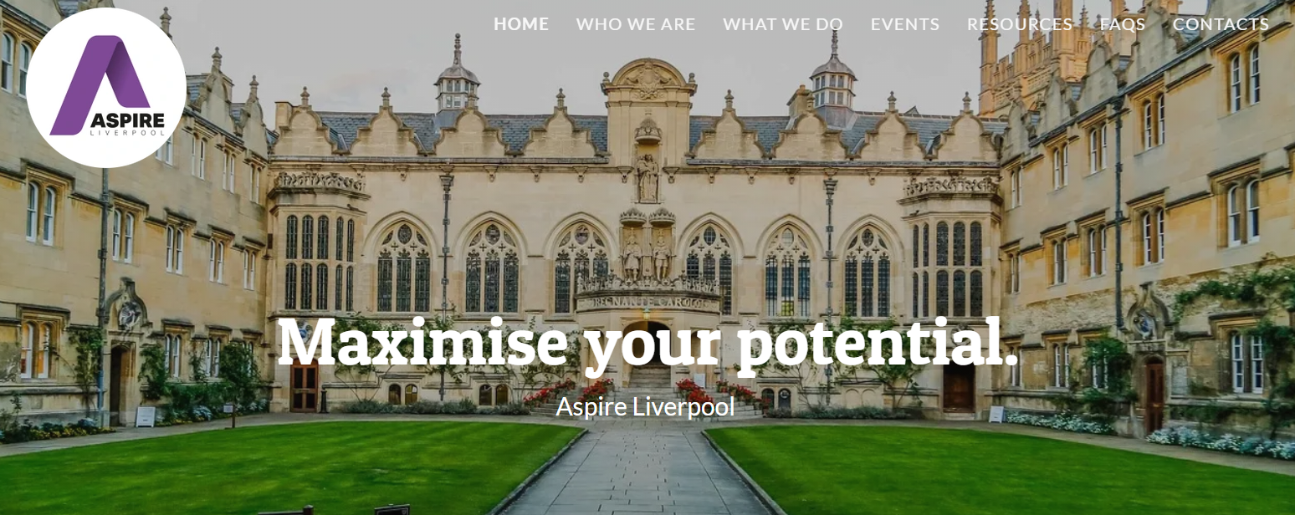
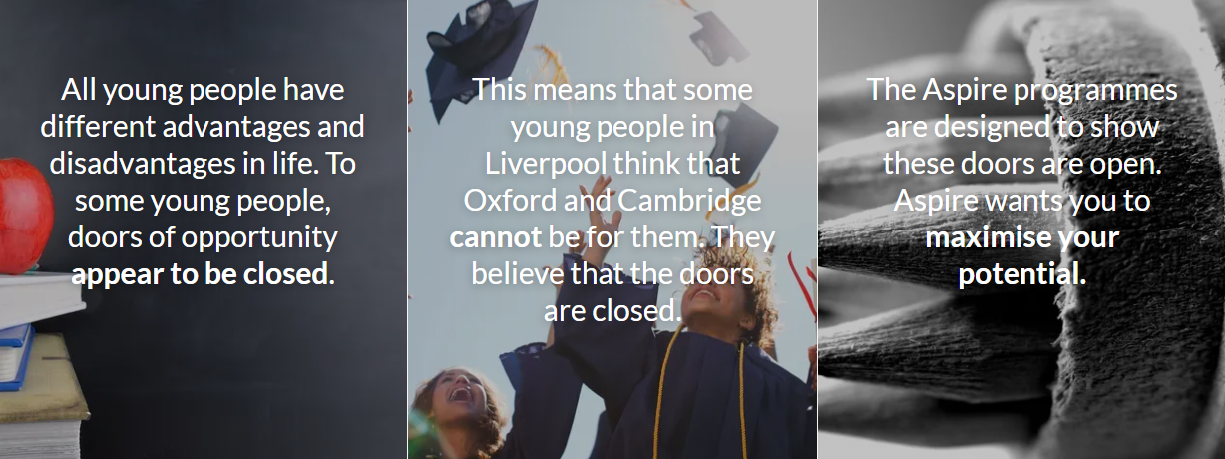

Slide 16
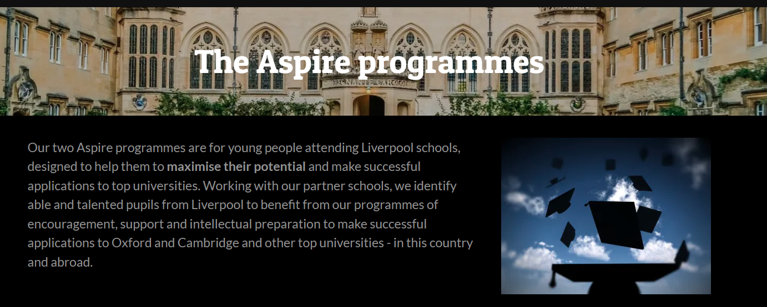
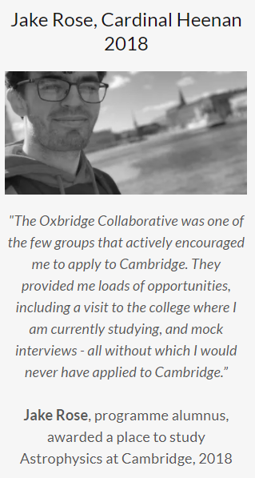

Slide 17
Find out more and apply for these opportunities
Social Mobility Foundation
https://www.socialmobility.org.uk/student
Liverpool Scholars
https://scholars-apply.liv.ac.uk/
Arts Emergency
https://www.arts-emergency.org/apply
Sutton Trust
https://www.suttontrust.com/our-programmes/
Aspire Liverpool
https://aspireliverpool.org.uk/
Find out more about Zero Gravity here
https://www.zerogravity.co.uk/

