Slide 1

Introduction to Student Finance
Cardinal Heenan High School
5th March 2026

Slide 2

Today’s talk will cover
Three phases of Student Finance
Before students go to university
Whilst students are at university
When students leave university

Slide 3



When to apply
2026 entry
30 April 2024
UCAS search displays courses
3 September
First day we can receive a completed application
15 October 2025
Deadline for courses in medicine, veterinary medicine/science, dentistry, and courses at Oxford or Cambridge
14 January 2026
UCAS equal consideration date
26 February
UCAS Extra opens
30 June
Last date to send an application
5 July
Clearing opens
14 May
UCAS application opens for 2025 entry
Notes:
Your course or programme of study is likely to be first and foremost in choosing a university – what really fires you up? What can you see yourself getting deeply into?
Once you have found this – you want to be with others who share this passion –
We hope you enjoy meeting the teaching staff, current students and fellow applicants on your course – who all share your passion for your subject.
We know how important it is for you to meet in person, to debate, discuss and learn from each other together with your tutor’s support.
So – our ambition is that you leave here as a genuine SUBJECT EXPERT.
But we also focus on your transferable digital skills and teach you how to operate in a data-rich world.
And of course – you need to be able to relate your course to the world outside!
So you’ll find out about how we integrate applied learning and real-world projects into your course.

Slide 4

What do students need to do?…
Before
Apply to Student Finance England or Wales
Research possible Bursaries, Scholarships, and Additional funding
Estimate their costs e.g. accommodation, transport, food, phone bill, socialising – this will help them to budget when at university

Slide 5

Tuition Fee Loan
Pays for university teaching and facilities
Up to £9,790 a year
Paid directly from Student Finance to your university
Every eligible student receives the same amount
Repaid after you leave university
Living Cost Loan
Can be used for accommodation, food, transport, course materials, socialising
Means tested – the amount you receive depends on your household circumstances
Paid to you in three instalments over the year
Repaid after you leave university

Slide 6

Maintenance for Living Costs Loans: Student Finance England
Parental home
Live at home while you study
Up to
£9,118
Living away from home
Outside of London
Up to
£10,830
London
Live away from home & study in London
Up to
£14,135
Maximum levels for 2026/27

Slide 7
Maintenance Support: Student Finance Wales
Parental home
Live at home while you study
£10,315
Living away from home
Outside of London
£12,345
London
Live away from home & study in London
£15,415
These figures show an estimate of how much a student could get based on their household income for 2026/27

Slide 8

How to apply
2026 Entry
Apply online at gov.uk/studentfinance
Apply early to make sure your money is ready for the start of your course
Students don’t need a confirmed place at university to apply
Apply with a preferred choice

Slide 9
What do students need to do?…
During
Complete their enrolment when they arrive at university
Using their estimated costs, create a budget, working out how many weeks they need each maintenance payment to last for, and how much they can spend
Reapply for finance each year (they will be reminded)

Slide 10

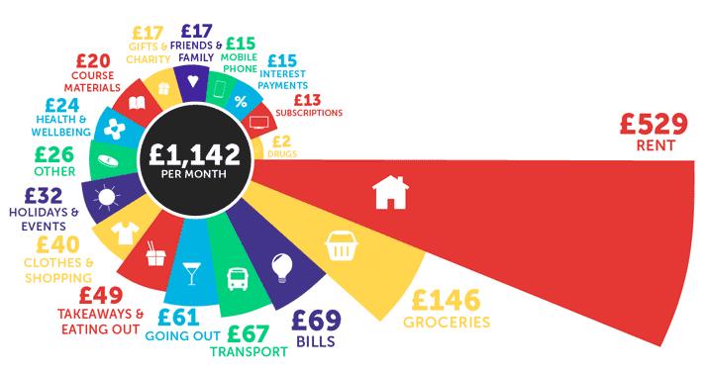
How much do students spend?
National Student Money Survey 2025 www.savethestudent.org

Slide 11
Frequently Asked Questions
What if a student decides not to go?
  Student Finance funds are only released once the student arrives and enrols at university. If they apply for finance but decide not go and never enrol, no money is released and they owe nothing
What if circumstances change during the degree?
  Students will re-apply for finance every year, and changes in household income can be adjusted year-to-year.
Part-Time Employment?
  It’s recommended that students don’t work for more than 16 hours a week to allow time for their studies.

Slide 12
Frequently Asked Questions
Interest Rates…
  Interest is charged from the day the first payment is made to the university or college until the loan is repaid in full or cancelled.
  The interest rate is based on the UK Retail Price Index (RPI) and will vary depending on the student’s circumstances.
  The interest rate is updated once a year in September, using the rate of RPI from March.
  While studying until entering repayment = RPI +3%
  On entering repayment interest is linked to earnings on a sliding scale up to a maximum of RPI + 3%

Slide 13
What do students need to do?…
After
Students will start to repay your loan the April after they leave university
They will not pay back anything until they earn over £25,000 a year
They will pay 9% of anything they earn over this threshold
Their repayments will be taken by HMRC along with tax, pension and National Insurance
Repayments stop after 40 years

Slide 14
Student Loan Repayments
Things to Remember
Repayments are based on income rather than what is owed
Students will never be asked to repay what they owe in full
The loan belongs to them, and no family member or partner can be asked to repay
If their income falls below the threshold, repayments stop
If they choose to work abroad, repayments will be taken through the local tax system where applicable, and adjusted for each country’s cost of living
The loan does not affect their ability to buy a house, car etc

Slide 15
Summary
A Tuition Fee Loan is available to all eligible students
Maintenance loans are calculated for everyone
Research all finance available
Apply online & on time – no need to wait for a confirmed place
The loan is considered a ‘non-toxic’ debt meaning it will not affect your credit-rating
Repayments will be linked to your income, not what you owe
In most cases, funding will only be provided once (course length +1) so make sure you want to go to university and have chosen the right course
chester.ac.uk

Slide 16
For more information…
On student finance and to apply go to
www.gov.uk/studentfinance
SFE experts are online Monday to Friday 9am-5pm and Saturday 9am-4pm to answer questions.

