Slide 1

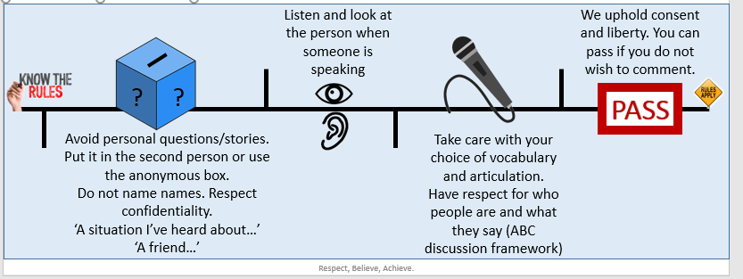
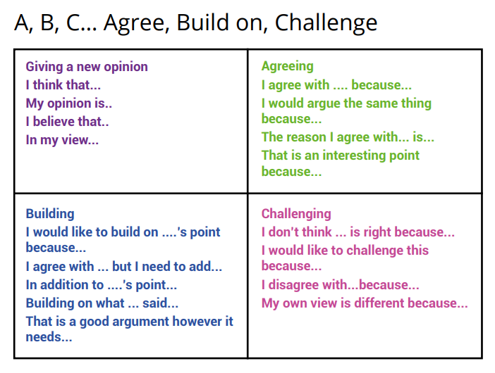
Curriculum for Life
Fortnightly Forum
Form Tutors should go through the ground rules with the students at the start of every forum/session. This enables us to establish what we established.
Everyone is entitled to their opinions, everyone has unconscious bias but discrimination, micro-aggressions and confrontation has no place in the forum as it infringes upon our upholding of British Values (see below if required).
Confidentiality: If someone overshares, what is said in the room stays in the room and is not for discussion outside the lesson. However, if someone discloses something about themselves which indicates that they might be at risk, a teacher would have to pass the information on in order to keep them safe.
This is a professional setting so we should use the appropriate tone and communication. ABC discussion framework – sentence starters on the top right of the slide.
This session could impact some people. If at any point someone needs to leave the room, to take some time, allow without hesitation.
During the forum, remember the ABC framework. This helps structure respectful responses.
The 4 fundamental British values are:
    Democracy
    Rule of Law
    Respect & Tolerance
    Individual Liberty
Fundamental British Values underpin what it is to be a citizen in a modern and diverse Great Britain valuing our community and celebrating diversity of the UK. Fundamental British Values are not exclusive to being British and are shared by other democratic countries as a way of creating an orderly society, where individual members can feel safe, valued and can contribute for the good of themselves and others.

Slide 2
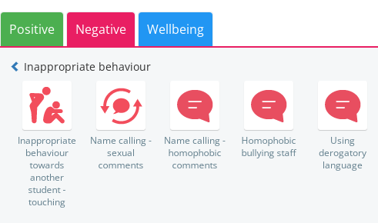



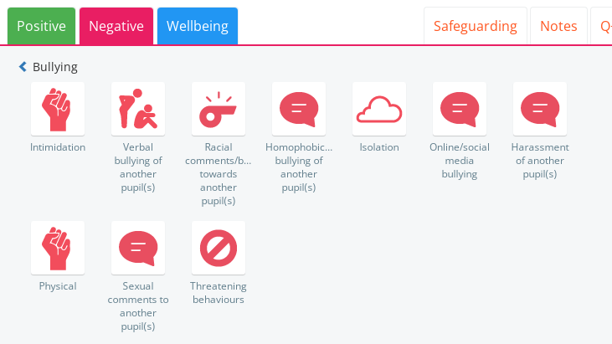
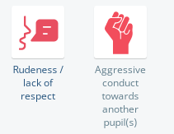
We actively use class charts. Any discriminatory language/comments/behaviour intending to cause harm is monitored and reported. Restorative discussions must take place during the session if and when required.
Who has been affected by what’s been said/done and in what way?
How could things have been done differently?
What do you think needs to happen to make things right?

