Slide 1


Notes:
I’m here today to talk about an opportunity for all those interested in creative and humanities subjects.

Slide 2

Are you interested in a career in the arts and creative industries?
Notes:
Put your hand up if you do study an arts or humanities subject - History, Music, Art, English?
Keep your hand up if you’ve ever considered a career in that subject area, but you’re unsure how to get there?
This is an opportunity for you!

Slide 3

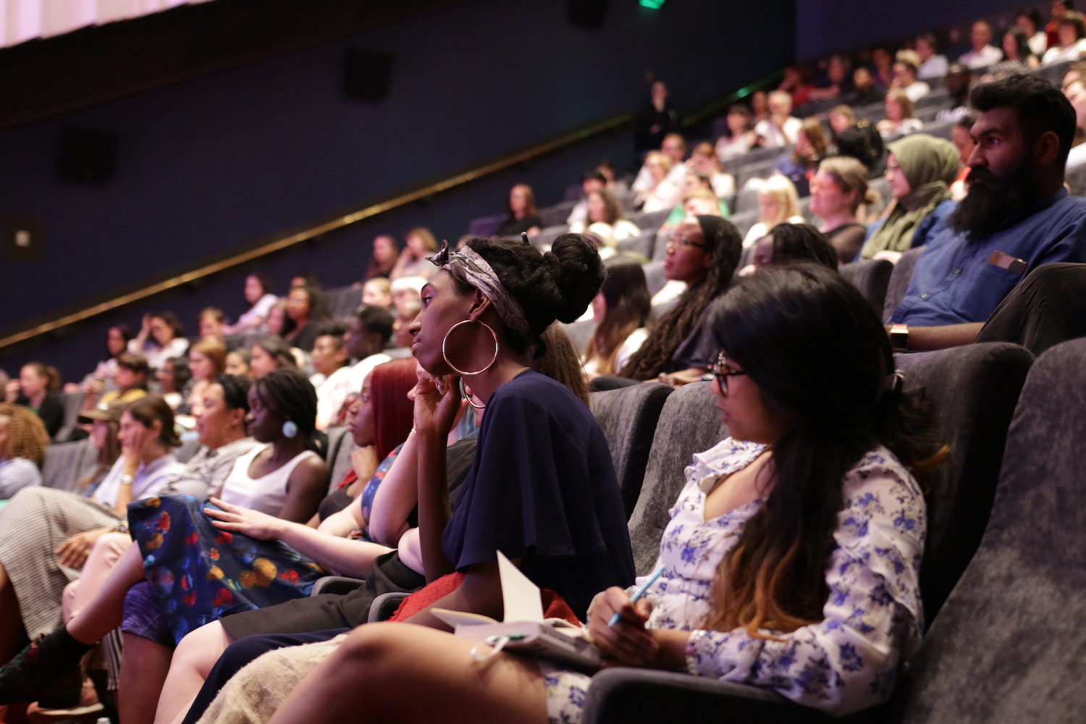
Who are we and what do we do?
We connect young people to mentors in the arts and creative industries.
We offer our Young Talent with information, opportunities and work experience in their areas of interest.
We run the Young Community which you will be part of until your 26th birthday!
Notes:
Starts with mentoring on a 12 month programme
We provide our Young Talent with opportunities, throughout their time on the programme through our newsletter and connecting them with professionals.
When the 12 month programme is finished you join our Young Community which will continue to support you until you turn 26. You can do take part in our coaching programme, gain access to paid work/free events/talks. Ways to build your experience.

Slide 4
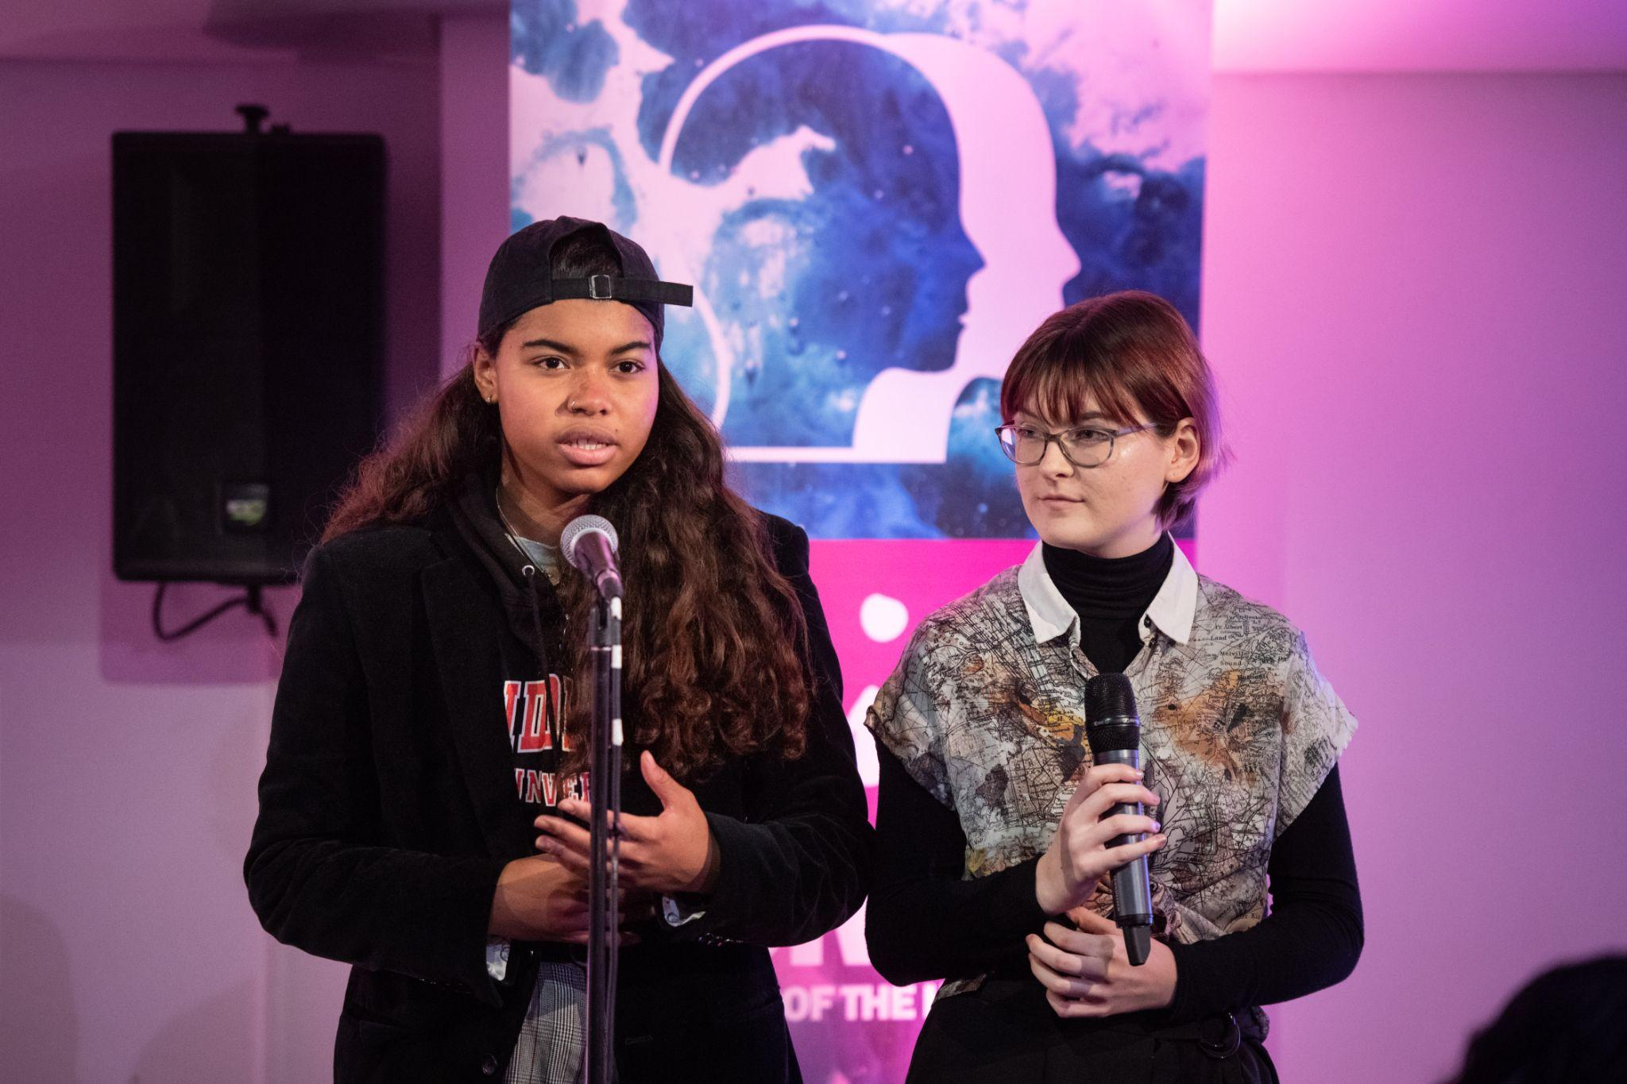
How does it work?
We pair you up with a mentor who shares your interests.
You meet with them once a month for 12 months. Mentoring will begin in January
You set goals based on what you want to achieve during your mentoring year and beyond!
Notes:
We will use this to pair you up with a mentor who can best support you throughout the year.
Throughout the year you will meet with your mentor once a month.
This can be in person in a public place, over Zoom or both! You can let us know your preferences before we pair you up.
Over the year, you and your mentor will work together to set yourself goals and work on ways to achieve them. You will have the opportunity to meet a range of professionals in different creative industries.

Slide 5
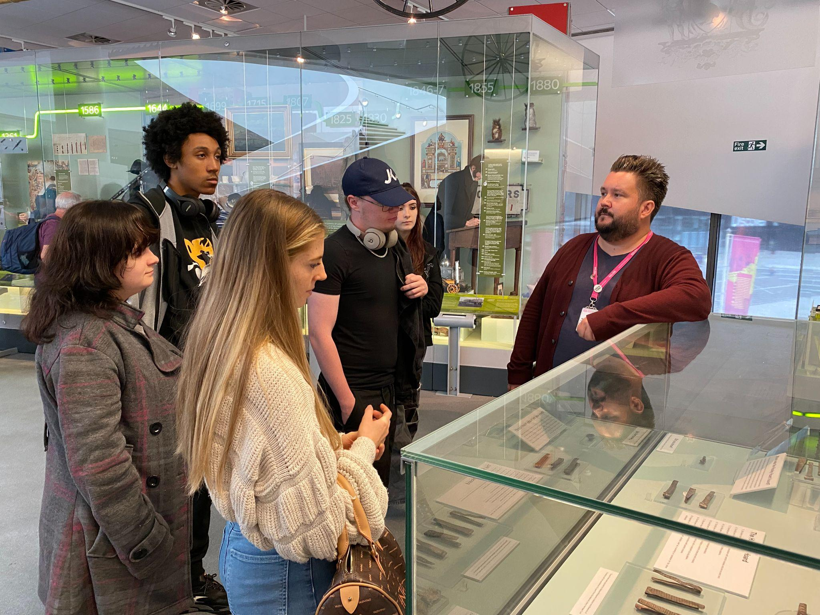
How can we help you?
Information, Advice and Guidance
Opportunities and Work Experience
Professional Connections and Networks
Helping you feel more confident!
Notes:
The great thing about the programme is that you can build it to your liking. You and your mentor discuss what you out of the meetings and go from there.
Wish List
Ruby Ticket Scheme
Ask Arts Emergency
Travel Bursary
The one thing that ALL our young people say at the end of the year is that they feel more confident IN THEMSELVES and IN WHAT THEY ARE GOING TO DO NEXT!!!

Slide 6
What areas do our mentors specialise in?
Architecture | Curating | Film & TV | Illustration | Politics
Art | Costume Design | Graphic Design | Journalism | Publishing
Acting | Dance | Games Design | Marketing & Advertising | Writing
Classics | English | History | Music | Directing
Comedy | Fashion | Interior Design | Museums | Philosophy
Notes:
Here are some of the areas our mentors have helped our mentees explore.
However, if there’s a creative area you’re interested in we will do our best to put you in touch with someone who can.

Slide 7

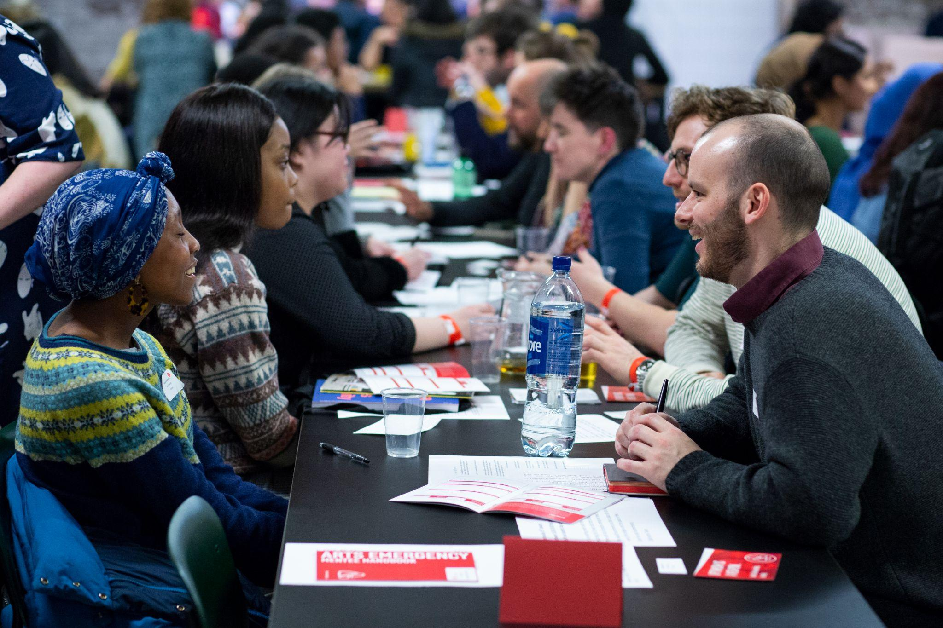
What are we looking for in a mentee?
A passion and curiosity to explore your areas of interest.
A commitment to meeting your mentor once a month for 12 months.
You meet Arts Emergency’s eligibility criteria!
Notes:
There is no pressure to know exactly what you want to do, you can spend the year exploring this but you will need to be curious!
We ask that you commit yourself to the programme fully. This is so you can get the most out of it! With this comes good communication. Want to make sure you’re making the most of the year. Attending meetings/ sharing interests/ taking part

Slide 8
What are we looking for in a mentee?
Every mentee must meet at least one of the criteria below:
If you’re not sure about your eligibility please contact us.
neither of my parents went to university
I am currently eligible for Free School Meals
I was eligible for Free School Meals between year 7 and year 11
I am a recipient of a 16-19 bursary
I would describe myself as Black, Asian or from an ethnic minority background
I have a disability
I have a learning disability and/or I have special educational needs
Arts Emergency also uses your postcode (the one where you spent most of your childhood) to assess the deprivation of the area as an indication of your eligibility for our mentoring programme
Notes:
These are our criteria,
we use the criteria to make sure we’re reaching young people who are in most need of our help,
and to help us prioritise those who are most in need of support
If you’re unsure whether you meet the criteria but you’re really up for joining the programme, get in touch and see! I’ll leave my email up for you at the end.

Slide 9
How to apply!

Slide 10

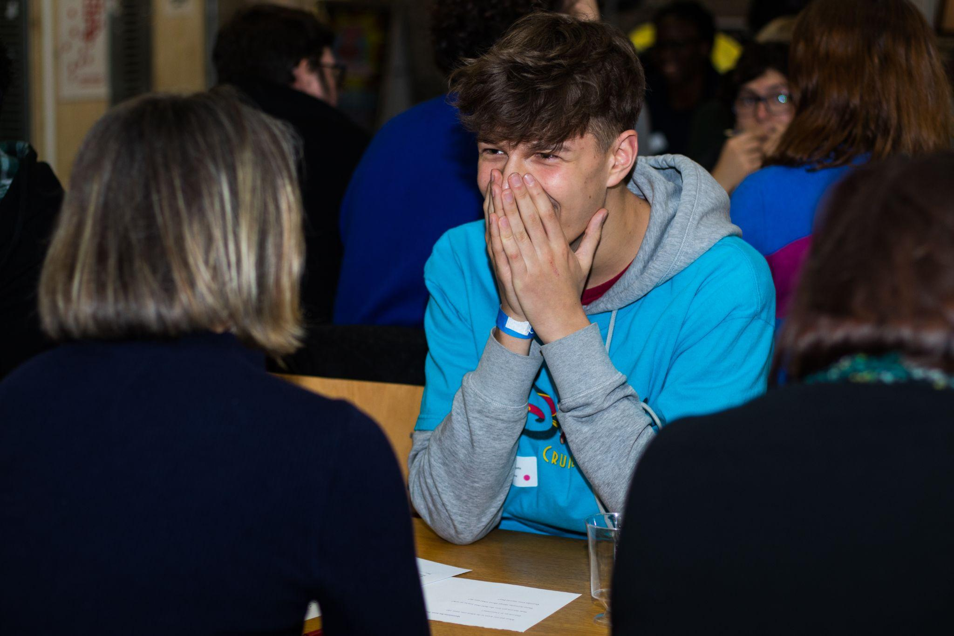
What happens?
You fill in an online form expressing your interest in the programme. Deadline: Monday 30 October
www.arts-emergency.org/young-people/get-a-mentor
We arrange an interview to get to know you
We arrange an introduction event so you can meet you mentor
You’re all set up to begin mentoring!
Notes:
The programme runs from January to January.
You fill in an online form expressing your interest in the programme
We arrange an interview to get to know you so we can pair you up as best as we can
Once we’ve paired you up with a mentor, we arrange a introduction event online so you can meet you mentor
You’re all set up! We will continue to support you throughout the year

Slide 11
Get in touch
Danny Kilbride
Merseyside Mentoring Officer
danny@arts-emergency.org
www.arts-emergency.org
@artsemergency

Slide 12
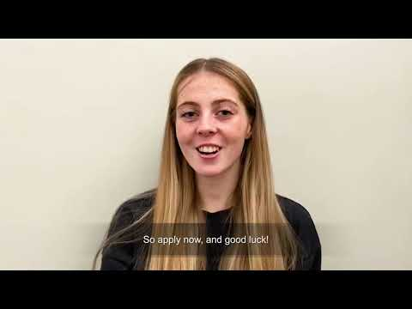

Slide 13


