Slide 1
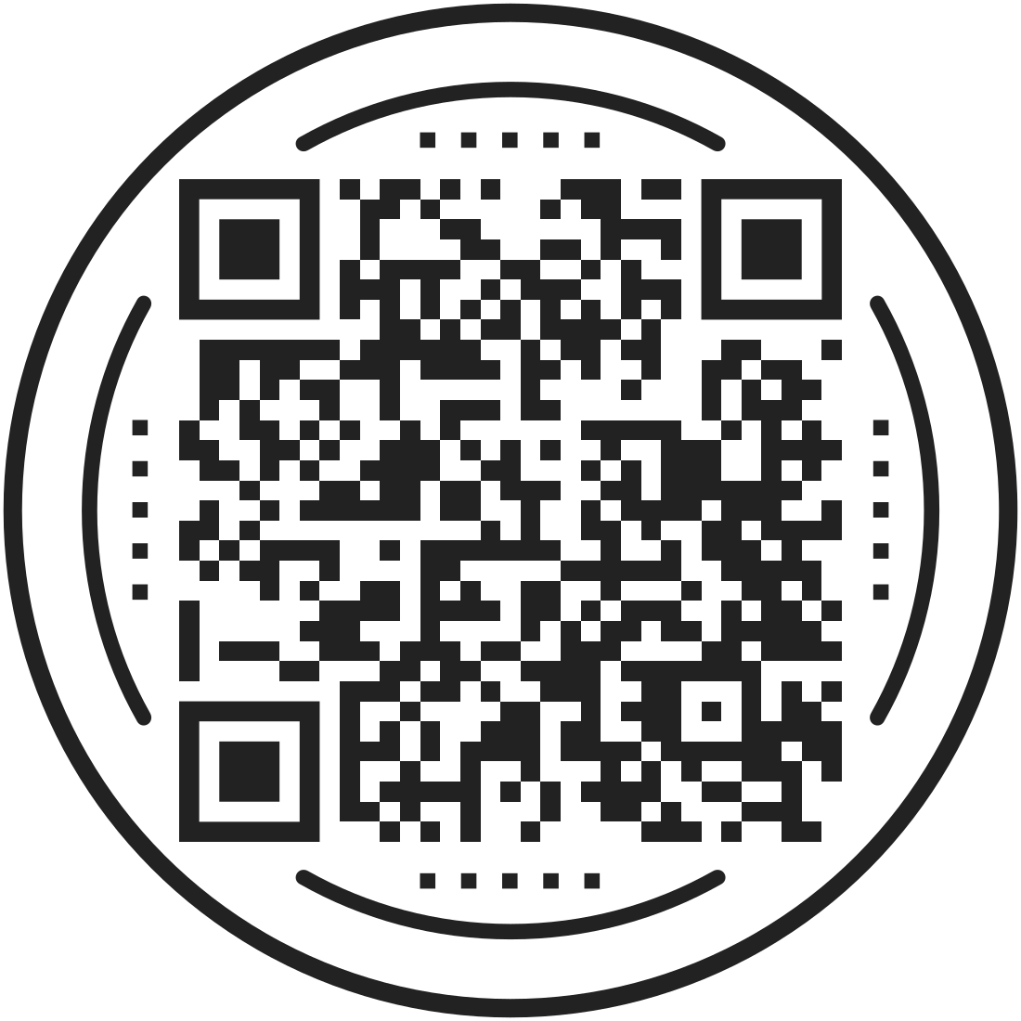

The Aspiring Professionals Programme
Scan to sign up for more info
Notes:
Welcome
Good morning/afternoon everyone, it’s great to be speaking with you all today. I’m [Name] and I’m with Social Mobility Foundation. The purpose of our presentation today is just to introduce you to our organisation and give you an idea of the critical support and opportunities we can offer you over the coming few years if you enrol onto our programme. The Social Mobility Foundation, or SMF, is a charity, and we exist to support high-achieving, ambitious students like yourselves in accessing top universities, but also in gaining employment in competitive and fulfilling professional industries afterwards.
If that’s piqued your interest already, then great – we’ll be running through the application process today, so you should leave this presentation equipped with everything you’ll need to know before submitting an application! We’ve also got a QR code on the screen which you can scan and use to input your contact details so we can keep in touch with you and update you on the progress of your application to the programme, should you choose to apply.

Slide 2
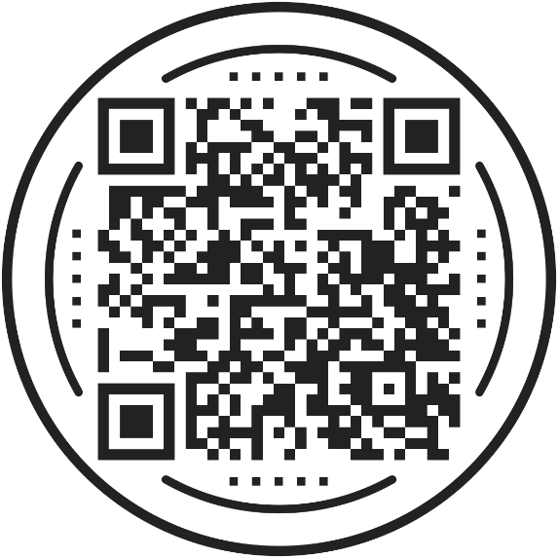
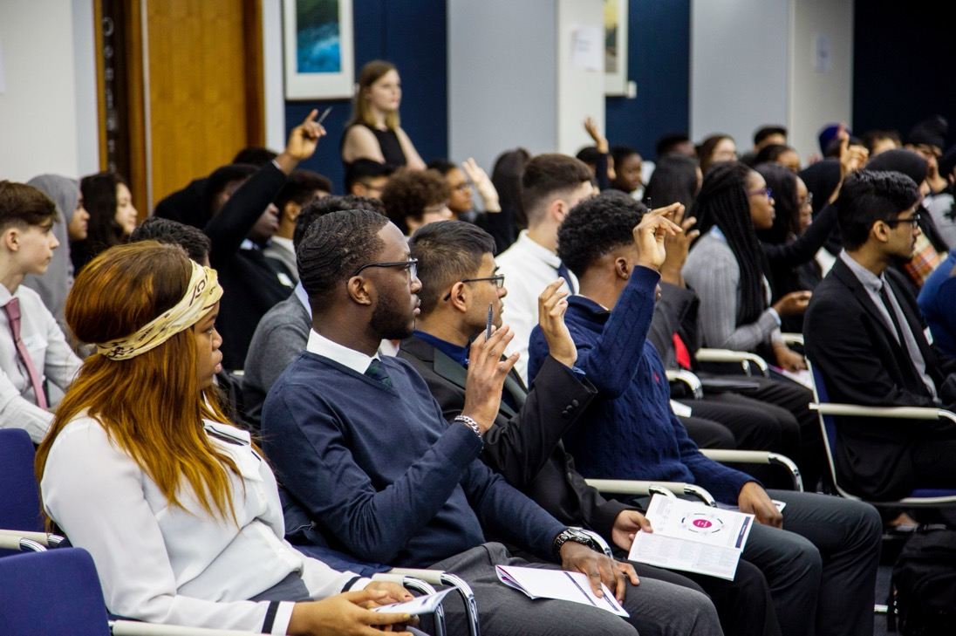

Scan to sign up for more info
We propel brilliant young people into university and professional life
Notes:
The SMF
The Social Mobility Foundation, or SMF, is a charity, and we exist to support high-achieving, ambitious students like yourselves in accessing top universities, but also in gaining employment in competitive and fulfilling professional industries afterwards.
If that’s piqued your interest already, then great – we’ll be running through the application process today, so you should leave this presentation equipped with everything you’ll need to know before submitting an application! We’ve also got a QR code on the screen which you can scan and use to input your contact details so we can keep in touch with you and update you on the progress of your application to the programme, should you choose to apply.
*give students time to scan the code/ fill out paper sign up sheet

Slide 3




The Aspiring Professionals Programme
University Application Advice
Mentoring
Skills Sessions
Internships
Notes:
Aspiring Professionals Programme
First, some essential information about our programme:
Our Aspiring Professionals Programme, or APP, is free of charge for everyone who is accepted. You’re eligible to apply for the programme from Year 12/S5 and it runs throughout the rest of school/college and university, right up until you graduate and enter that dream profession. So unlike other programmes, we don’t just concentrate on university admissions or career development; the Aspiring Professionals Programme encompasses both of these.
The support that we can offer you comes in the form of four major pillars, which you can see on the screen now.

Slide 4

What we offer
Intro to Russell Group universities, including free visits to them
Personal statement workshops and checking service
Oxford/Cambridge admissions
and interview support
University
Application Advice
Medicine admissions and interview support
Results Day support, in the lead up and on the day
Notes:
University Application Advice
To take the first of these pillars, we can offer extensive guidance on choosing and applying to top universities.
We offer students the opportunity to visit prestigious universities for free – not just as open days but as overnight stays where they can participate in skills sessions and get a real taste for university life. In 2023 we took 50 students to Durham University and 93 students on four different trips to Oxford.
And then when it comes to writing your personal statement, not only do we offer several workshops dedicated to them, but we also run a Personal Statement Checking Service in which you can have your personal statement looked over by a professional in the field you’re most interested in, and they’ll provide you with tailored feedback on your final draft.
Moreover, if you want to apply for Medicine, Law or Oxbridge, we’ll run plenty of workshops throughout the year aimed at giving you extra guidance on their admissions and interview processes, including tests such as the UCAT and BMAT for medical schools.
We were also very proud this year to launch an additional form of provision for our students all about results day and navigating what we know can be a stressful day for you. So not only did we put on webinars and produce guides that helped demystify results day, such as what clearing is and how to use it, we offered on-the-day support where students could call up and speak to us directly.

Slide 5

What we offer
Guaranteed for every student
Email mentoring via secure site
Mentor works in your chosen sector
Career guidance and insight into the working world
Professional Mentoring
We take care of DBS/PVG checks
Notes:
Professional Mentoring
Next up: our mentoring programme. Once you’re on the programme, we will match you with a professional mentor who works in your career sector of choice. These volunteers are a vital point of contact who can provide you with first-hand insight into the world of work within your chosen sector, offer career advice and even another pair of eyes to look over things like personal statements and written applications.

Slide 6

What we offer
Prepare for interacting with professionals
Employability skills – professional emails, phone calls, networking
Tailored to career sector preference
Skills Sessions
Contact with professionals
Notes:
Skills Sessions
The third area of support are the numerous skills sessions we run throughout the year. These sessions can be invaluable for professional develop, as we offer workshops that focus on upskilling your employability such as networking and personal branding, but also for your personal development as we provide workshops on building confidence and resilience as well as communicating with impact. Lots of the skills sessions can also be specific to your chosen career sector, wherein we invite experts from within that sector to speak with our students.
All of our events are outside of school or college time and where you’re required to travel into a city, we can cover your travel costs to and from home if this is a concern for you.

Slide 7

What we offer
Summer and October holidays
Employers across UK
Student engagement contributes to chance of being offered internship
Internships
Matched in your sector preference
First hand insight and experience
Notes:
Internships
Finally, the one that I know a lot of you will be interested in… internships! We know that how difficult finding relevant work experience can be when you do not have pre-existing connections in the profession you’re interested in, so we work with lots of employers across the UK who run internships for our students during summer and October holidays. These internships are highly sought-after, and you can help yourself secure a place on one of them by engaging meaningfully with our programme (such as by responding to our communications, attending our workshops and participating in them enthusiastically).
Being on one of our internships can deepen your understanding of the profession, show you what different roles and pathways you can pursue and will help you to make an informed choice about your future. What’s more, they really help you stand out on your personal statement and on any future CV’s, and can even help in building networks as you navigate the first stages of your career.

Slide 8
Programmes designed around you
APP City
APP Employer Insight
APP Reach
Based in Birmingham, Cardiff, Glasgow, Leeds, Liverpool, London, Manchester, Newcastle
All sectors
Face-to-face and virtual support
Sector or employer insight with top employers:
Selected sectors
Guaranteed face-to-face residentials
Open to students across the UK
All sectors
Virtual support with face-to-face support dependent on location and capacity
Year 12/S5/
Lower Sixth
Year 13/S6/
Upper Sixth
Employment!
University
Notes:
Programmes designed around you
We pride ourselves on offering this baseline of high-quality support to all of our students, but our Aspiring Professionals Programme is actually composed of several strands. As these strands are based on your interests and eligibility, they will also inform the scope and shape of the support that you receive.
[Remove paragraphs below if not needed, acknowledge other strands but focus on the aspect of the APP most relevant to the school/sixth form]
APP City:
This is our flagship programme and is open to those who live within an hour of Birmingham, Leeds, Liverpool or Manchester, or within an hour and a half of Cardiff, Glasgow or Newcastle, or within the M25 in London. Students on this programme receive a blend of both online and face-to-face opportunities, from workshops to internships, and we have 12 sectors that we cater to on this programme … we’ll be going over what sectors these are in a few slides time.
Employer Insight:
If you have specific sector interests, you can also apply for the Employer Insight strand of the Aspiring Professionals Programme. This is open to students anywhere in the UK (outside of London) but is more selective than APP City because students accepted onto this programme are guaranteed to take part in a residential internship with an industry-leading employer, most often based in London. You will still receive the same core support as other SMF students, such as being paired with a professional mentor, or taking part in skills development sessions, but, in the case of Employer Insight students these are often supplied first-hand by the employer you are interning with. We also want to highlight that when you’re taking part in these internships, all accommodation, food, and travel costs will be covered if you are successful in getting a place on an Employer Insight Programme. Moreover, you can only apply to one Employer Insight, so make sure to scan the QR code when it pops back up again if you want more information on this.
APP Reach:
Our third strand, APP Reach, is designed for students who live outside of our target cities or for those who just miss out on meeting our core academic criteria. On APP Reach all 11 of the career sectors are open to you, and you’ll receive a wealth of online opportunities in addition to a dedication from us to ensuring that opportunities which are often clustered in major cities are opened up to students who aren’t within their usual proximity.
Based on your location and whether you fall into APP City or Reach, you can apply to either PLUS an Employer Insight residential opportunity!

Slide 9
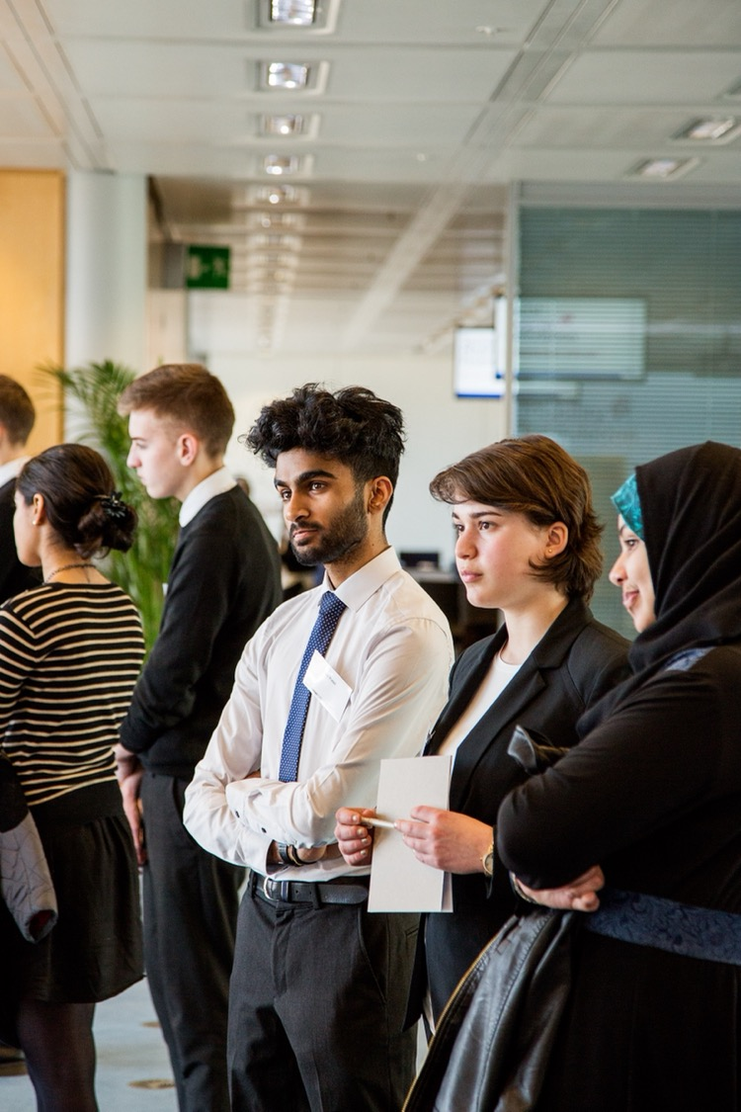

Who can apply?
Use the online application form to check your eligibility
Eligible for free school meals
First generation to attend university
Are care-experienced
Household income is below £45,000
Parent/guardian occupation in target group
Academic Criteria:
Are in Year 12/S5 and are taking A-Level subjects
Achieved four GCSE’s at grade 7
Achieved four GCSE’s grade 9-4
APP City & Employer Insight
APP Reach/Care experienced
Background Criteria:
or
or
You need to meet at least two of these to be eligible.
Notes:
Who can apply?
So who can apply for each of those programmes? At the SMF we want to work with as many bright, young individuals such as yourselves as possible, so our eligibility criteria is built around your needs and aspirations, and is divided into two main elements.
The first is all to do with your education and academics, and…
…regardless of which programme you apply for, in order to be eligible you have to be in Year 12/S5 and taking A-Level subjects.
Then, to be eligible for APP City and/or are interested in applying for one of our Employer Insight programmes, you will need to have achieved a minimum of four GCSE’s/National 5s at grade 7/A or above…
Alternatively, APP Reach has a wider academic criteria of four GCSE’s/National 5s at grade 9-4/A*-C. Also - if you’re a care-experienced student, you only have to meet the Reach criteria in order to be eligible.
The second component of our criteria is focused on your background, and this doesn’t change regardless of the strand of the programme you’re applying for. There are two ways of meeting the background criteria, option A and option B…
For Option A, you meet our background criteria if you are either
are free school meal eligible or
a care-experienced student
If you’re not either of those, that’s totally fine - you are still eligible for our programme so long as you meet at least two of the following …
be the first generation within your family to go to university (and, to be clear, at the SMF we count you as ‘first generation’ even if your parents were mature students or went to a university abroad, and even if you have older siblings at university).
Have a household income of less than £45,000 per year
If your highest paid parent/guardian’s occupation falls into one of our target groups…
If you’re still not completely sure if you’re eligible, then don’t worry at all, start an application with us and our application form will do all the work for you!

Slide 10
Which careers and sectors do we support?
Accountancy*
Architecture*
Banking & Finance*
Biology & Chemistry*
Business
Digital
Engineering & Physics*
Law
Media & Communications
Medicine*
Politics
No Preference
*These sectors or their Employer Insight programmes have subject requirements aligned with standard university requirements
Notes:
Which careers are supported?
Moving on now to discuss the wide breadth of sectors that we cater to on the programme, as I’m sure you’re all curious. As you’ll see, some of these are named professions, such as Architecture, Law and Medicine. However, many are much broader; for example, Digital covers disciplines like computer science, software development and gaming, for example.
In a similar vein, Biology & Chemistry is suitable for students interested in either of these subjects, and who want to explore careers in those areas. Likewise, for Engineering & Physics, you don’t need to be equally interested in Engineering and Physics, it could be just one of those subjects, or it could indeed be both. Media & Communications is also an excitingly expansive career avenue as it includes everything from journalism to advertising, to publishing or PR.
We also have our No Preference sector which is for students who are unsure about what career they want to move into, but also have lots of students who are interested in Humanities subjects, Social Sciences or Modern Foreign Languages also apply to this sector.
We unfortunately do not support students who want to go into dentistry, veterinary science or teaching, as we want to ensure the support we can offer students across all of our sectors is of an extremely high-quality and can be sustained throughout your entire time on the programme, but as it stands, we don’t have mentors or specific opportunities in these areas.
Finally, some of the sectors have additional requirements, so that we know you’re on the right track to get into relevant courses at university. For example, you’ll need to be studying sciences to be accepted into the Medicine sector and need slightly higher grades than other sectors. More details on these can be found on our website, or in the Student Guidance Notes which we will share with you.

Slide 11









Some Employer Insight programmes
Notes:
Employer Insight programmes
As I mentioned earlier, you can also apply for one of our Employer Insight programmes, which include a face-to-face residential stay, typically in London.
I’m sure you’ll recognise some of these names of the employers who run these residentials, but maybe not all of them. Rest assured, they’re all huge names within their respective industries and the feedback that we’ve received from our students who have interned with these employers which I’ll be showing you in a few slides really speak for themselves.
The Employers we worked with this year for those insight programmes include:
APP J.P. Morgan Finance Programme – for students interested in banking and finance, investment banking, mathematics and economics
APP J.P. Morgan Digital Programme – for students interested in computer science, financial technology, cyber security, coding and system design
APP BP Engineering Programme – for students interested in engineering
APP PA Consulting Springboard Programme – for students interested in general business, consultancy, politics, and sustainability. This work experience programme is shaped around the UN Sustainable goals.
APP Medicine Insight Programme – for students interested in pursuing Medicine, our Employer Insight is with who else but the NHS? - This programme is only open to students within England
APP Law Insight Programme – finally, for students interested in pursuing law we have a range of programmes with different law firms. We’ll explain more about these on the next slide

Slide 12
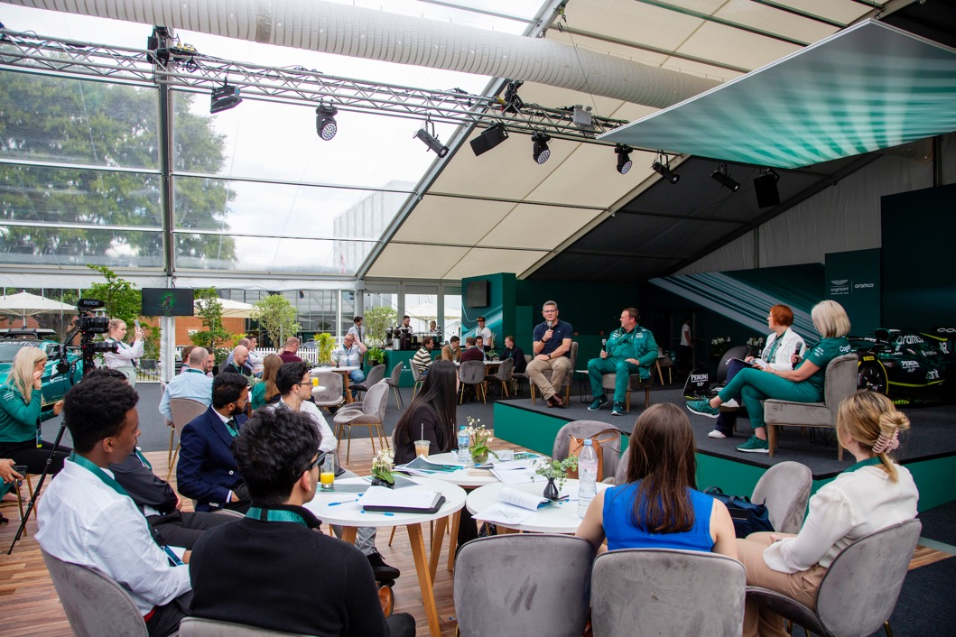
Undergraduate Programme
Pre-University Crash Course
CV Writing
Interview Practice
Recruitment Tips
Application Support
Commercial Awareness
Notes:
UAPP
Now what we’re really proud of, as an organisation, is that the support we offer to our students does not stop at the point at which you’ve secured a place at university. All of those insight programmes do take place within the timeframe of sixth form/college (so you could be on one of those internships by the time summer rolls around!), but we by no means consider that to be job done. We will support you throughout university until you graduate and even thereafter. During which time our support transitions from a focus on areas like university applications to include things such as expert recruitment tips, CV advice, job application and interview guidance.
And not to mention that internship opportunities continue to be offered to our undergraduate students too, and we collaborate with top employers to ensure our students are the first to hear about internships and employment opportunities in their relevant sectors.

Slide 13
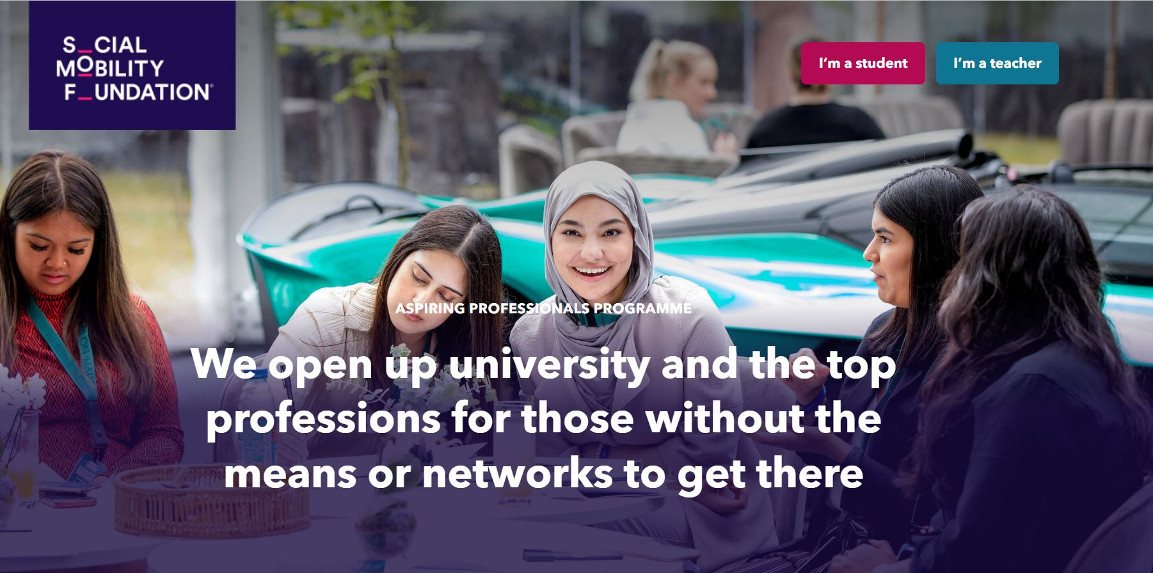
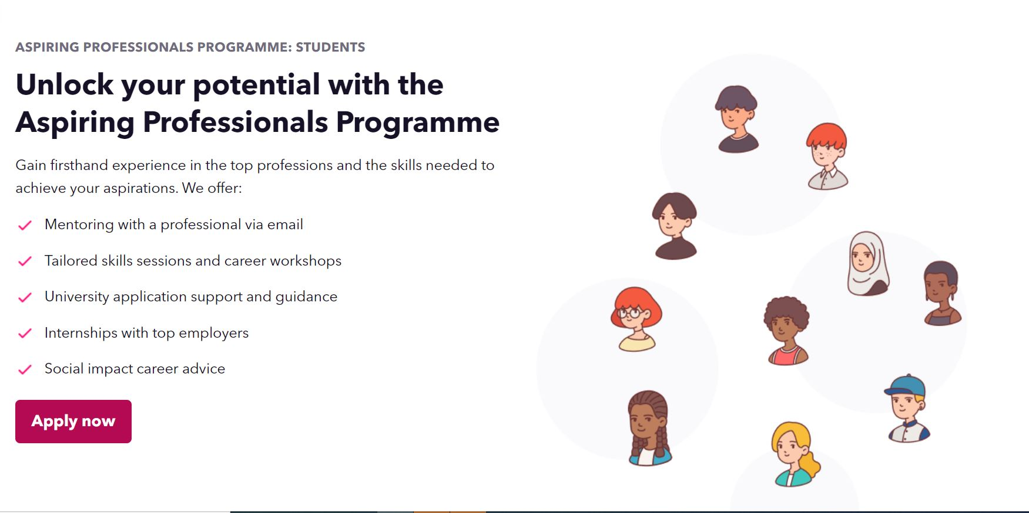
Start your application now!
DEADLINE:
12 noon
Friday 15th December 2023
Notes:
Applications
Now I hope we’ve done our job in demonstrating how transformative the Aspiring Professionals Programme can be for you and, as a result, you’re already thinking about signing up.
To do so you’ll need to go to our website - which got a brand new makeover this summer ready for all of our new applicants – or if you use the QR code on the next few slides to sign up for more information we can even send you the link to our application form.
And, as you can see, applications are now open! So you can leave this presentation today and get one started if you wanted to, but just be sure to get it submitted before 12pm on Friday 15th December!
We always advise students to submit early as we start assessing applications before the final deadline

Slide 14
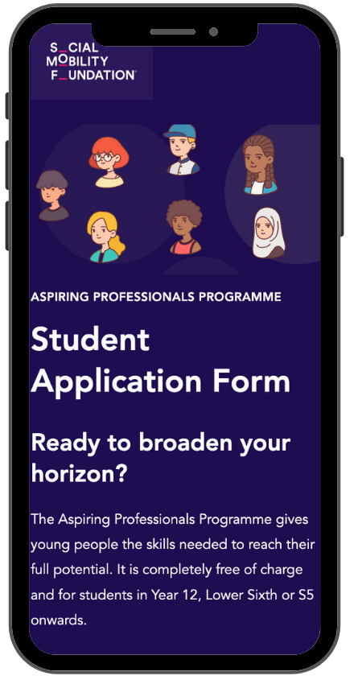
Application Process
Part 1 – Checking Your Eligibility
Personal details and background
Your education
Sector preferences
Part 2 – Getting to Know You
Five assessment questions
Interests, aspirations, opinions
Use the guidance notes if needed!
Nominate your Teacher Reference
Notes:
Application Process
Our application process is designed to be as smoothly as possible and, if you’re unsure about whether or not you’re eligible, will help do this for you. The application can be split up into two primary sections:
First, we ask for some information about you to check if you’re eligible for our programmes – so this will include questions about your academic history and your personal background. We’ll also ask about your sector preferences in this section.
The section part of our application is an opportunity for us to tell us about yourself and your ambitions and opinions in your own words. This stage is really crucial as the questions we ask you, like what do you think is a major problem the world is facing at the moment and who you’d have as a dinner guest, are not only an opportunity to show us at the SMF your chops, but will be used to match you to a mentor, and, if you’re offered an internship, could be sent to the employers so they can read about your interests.
Because of this, it's absolutely imperative that you put some time and effort into them and check for spelling and grammar! You can even ask your teacher to review them before submitting. And, again, you can use the student guidance we’ll be sharing later to help you!

Slide 15

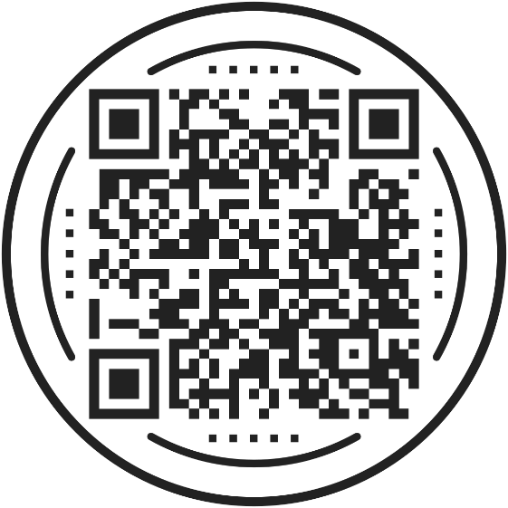




Get in touch!
Applications open: 20th September
Applications close:
15th December 12pm
0207 183 1189
app@socialmobility.org.uk
socialmobilityfoundation
TheSocialMobilityFoundation
@SocialMobilityF
socialmobility.org.uk
Notes:
Get in touch and thank you!
We’ve reached the end of my presentation, and I really hope that was helpful for you in demonstrating how we can support you with developing towards your next steps in education and work and succeeding in your dream career. We are passionate about the fact that anyone who has a lack of networks or connections should not be held back by this in their career aspirations, and so we want to be able to support as many students as we can!
Our contact details are here in case you want to get in touch with us, along with that QR code again – if you have any questions at all we’d love to hear from you. We’ll email you in the next couple of days with some useful links to things like our student guidance notes too.
To end, I want to thank you so much for joining me today and hearing us out! We’ll hopefully speak to you again soon, and we’re looking forward to seeing your applications to the Aspiring Professionals Programme! Best of luck with the rest of your studies in the meantime!

