Slide 1
Notes:
Introduce yourselves to the students-
Your name, year of study etc

Slide 2
Liverpool Scholars Programme
Do you want more support to feel prepared for university?
Would you value financial support such as a guaranteed scholarship, a reduction in accommodation fees and more?
Does a reduction in the entry requirements for every course in Uni of Liverpool sound like it might be useful for you?
Notes:
A short, snappy intro!
Prepared- know what to apply for, what universities, how to etc
Financial Support- It is known that there are fees attached to university and it would be nice to have some financial support
Reduction (a small safety net around your grades to help you aim high? We’ll talk more about this later).

Slide 3
What do our students say?
Youtube video here:
Notes:
If you have answered yes to any of the previous questions, then the Liverpool Scholars Programme is for you. Listen to some of our alumni here, YOUTUBE LINK:
https://www.youtube.com/watch?v=MXm7tfUplLI

Slide 4
Why else should I be a Scholar?
On successful completion you get these benefits:
Guaranteed conditional offer at the University of Liverpool for programmes you are eligible to apply for
Offer reduced by two A-level grades or equivalent
(for example, A,B, B = B, B, C)
The Liverpool Scholars Award
(Currently a £2000 bursary for every year of your undergraduate study here at the University).
Notes:
If students successfully complete the Liverpool Scholars Programme, they will be eligible for the benefits listed here.
They will receive a guaranteed conditional offer from UoL for courses they are eligible for (students must check eligibility criteria, such as GCSEs, required qualifications, work experience etc)
This offer will be reduced by 2 A-Level grades or equivalent (for example BTECS)
A bursary for every year of UG study (typically 3 years)- this is paid in 3 instalments throughout the year and is a non means tested, non repayable cash bursary.

Slide 5
Compulsory dates & activities
Scholars ‘Programme Launch’ on Saturday 27th January 2024
The Scholars ‘Welcome Day’ in February 15th or 22nd 2024 (depending on your school)
One ‘Academic Discovery Day’ in April 2024 (Easter Half Term) on either 10th, 11th and 12th April (you book onto a date).
To complete the programme you must complete a ‘Reflection Piece’. This is a short essay of 500 words reflecting on one of the events you have taken part in.
You will be given guidance and support to complete this
Notes:
These are the events and activities students must complete in order to pass the scholars programme. One takes place on a weekend and others during the half terms in year 12. The programme is here to complement your studies and we aim to work around that.
Programme Launch- a chance for yourselves and your parents/carers to gain a refresher and a greater understanding of the programme
Welcome Day- an event where you get to understand more about university in general- what is the difference between universities, how do you select a course, how do you join societies. The day you are allocated depends on your school.
Academic Discovery Day - The final compulsory event is the Academic Discovery Day, which is during easter/spring half term and will give you an understanding about studying at university. You’ll cover important things that are relevant to you now, such as how to use AI in your studies, and experience subject tasters. You have three opportunities to attend an ADD, either 10th, 11 or 12th April. You only need to attend one day.
Finally, to complete scholars, you must complete a short reflection piece (less than one page of a4), where you will reflect on one of these events. We will provide you with guidance. This is to be completed over the Summer of Y12.

Slide 6
Optional Activities
As a Liverpool Scholar, you are prioritised for other events and activities. Take part in as much or as little as you like!
Year 13 Mentoring Support for your A-Level and BTEC Level 3
UCAS Application Support
Personal Statement Checking Service
Subject Tasters such as STEM Masterclasses fully paid for by the Scholars Programme
Notes:
These are all the optional things that you can make the most of through the Liverpool Scholars Programme. You do not have to do these, but they are really helpful for most of our students!

Slide 7
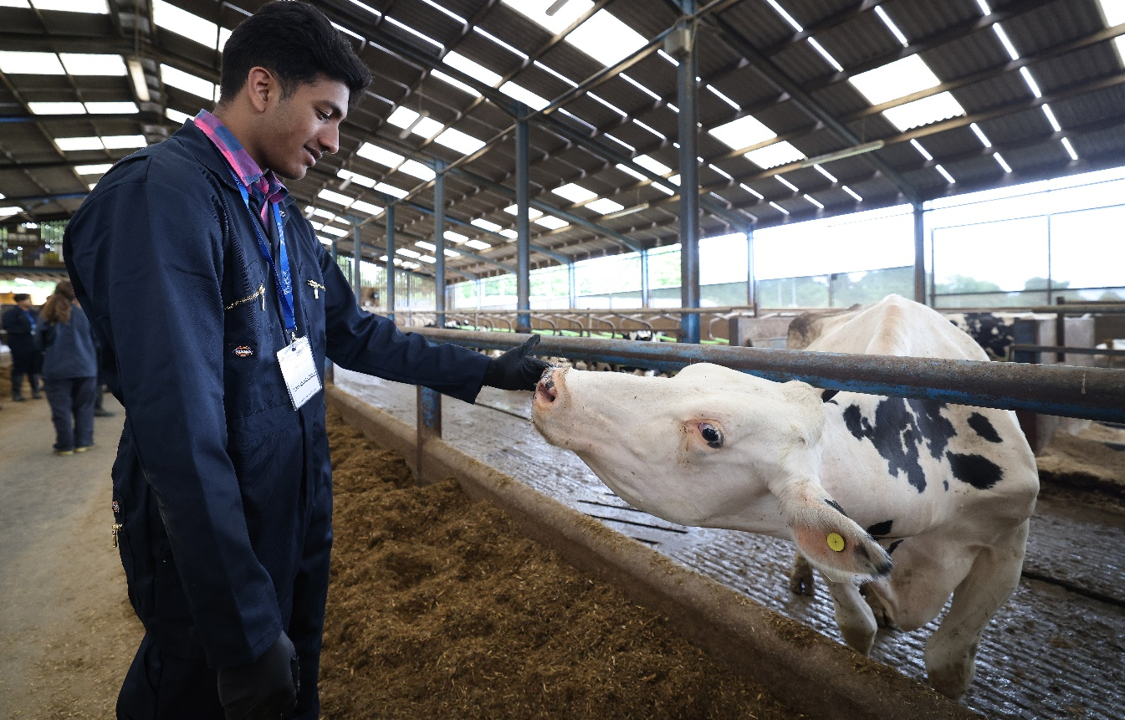
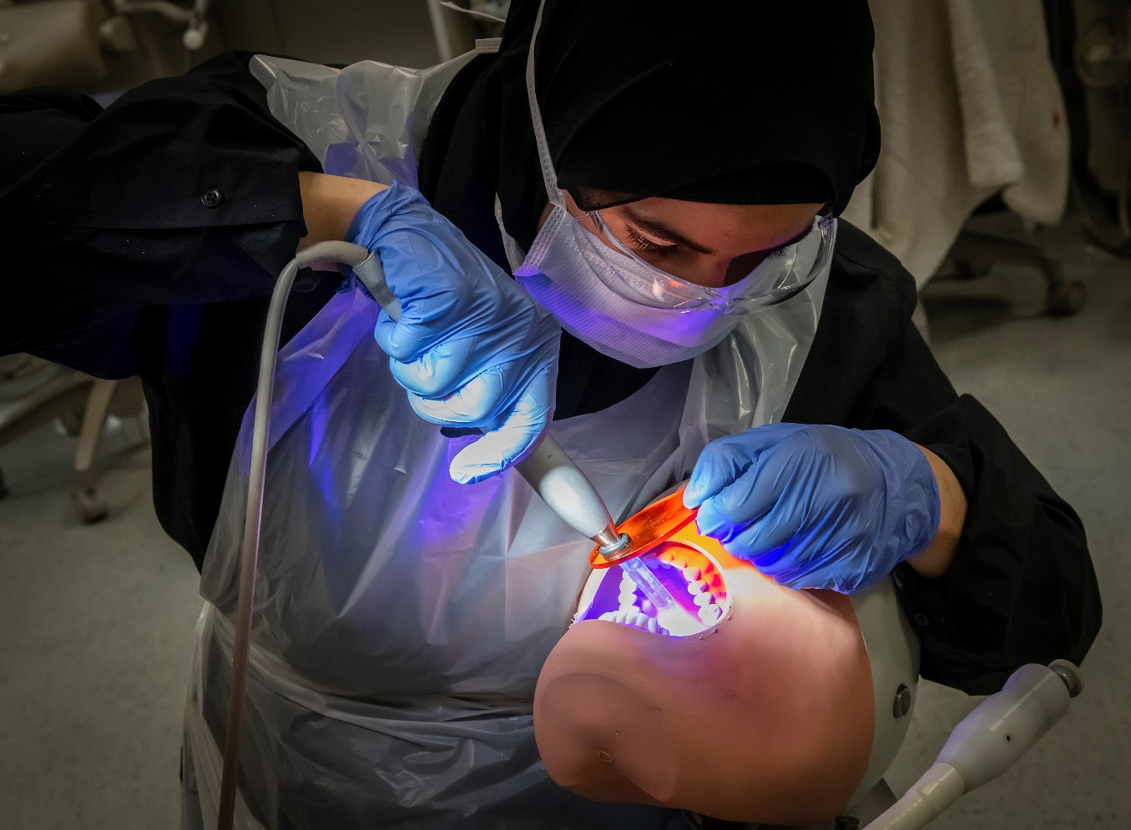
Destination Summer Schools
As Scholars, you will be prioritised for the Year 12 Clinical Summer Schools.
Destination Medicine
  3 day non residential event for students wishing to apply for Medicine at the University of Liverpool
Destination Vets
  3 day residential for students with an application into Veterinary Science at the University of Liverpool
Destination Dentistry
  3 day residential event for Year 12 students hoping to apply for Dentistry and/or Dental Therapy
Notes:
As Scholars, you will be prioritised for these summer schools. These are for students who are interested in these really competitive subjects.

Slide 8
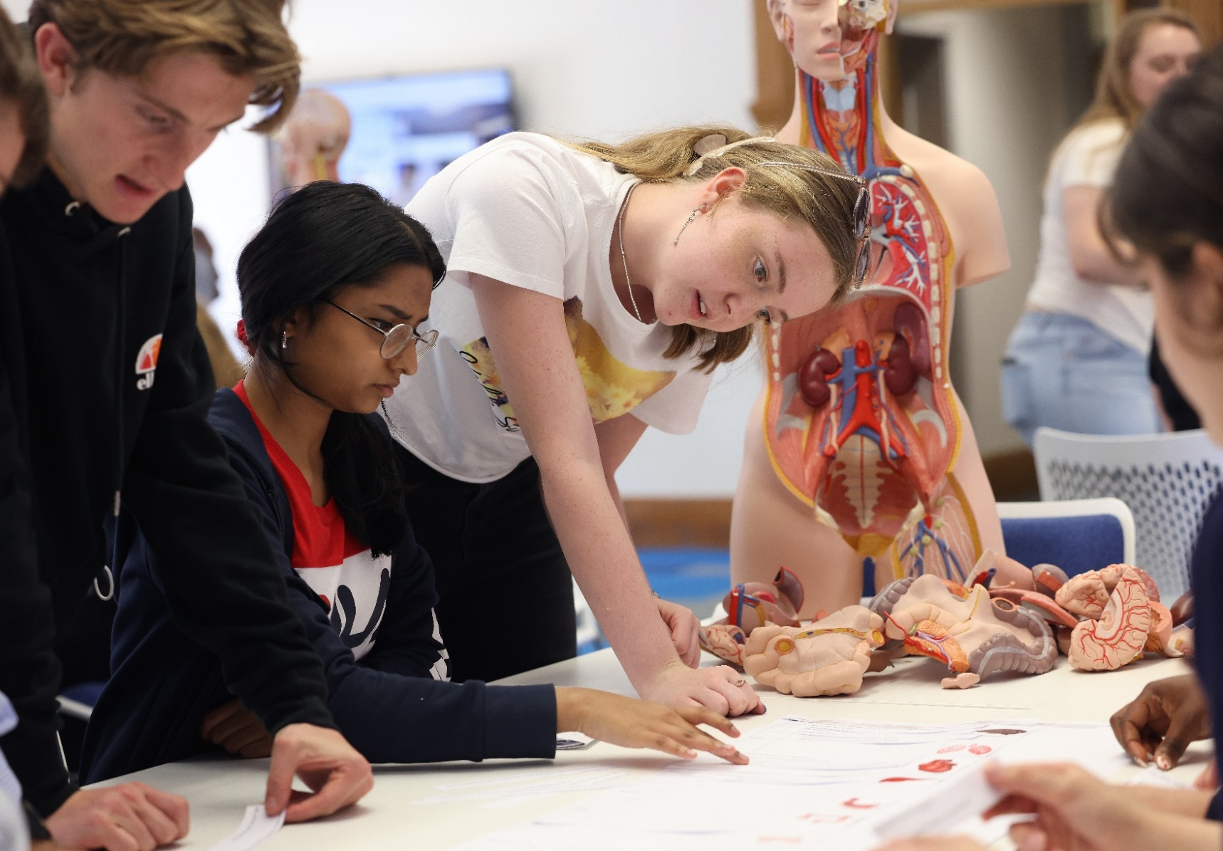
Destination Summer Schools
What do these summer schools provide?
A chance to experience life a student in that field at the University of Liverpool
The opportunity to meet and chat to Undergraduate students in that field at the University of Liverpool
A moment to understand, think about and discuss the admissions process with the University organisers (admissions team) and discuss how to prepare to apply
Gain a taster into studying that field

Slide 9
What we do:
What we ask:
  Introducing you to higher education and do everything we can to give you the opportunity to progress onto The University of Liverpool
  Introducing you to academic skills which will help you succeed in higher education
  Offer you the opportunity to get involved in wider university activities
  Prioritise you for as many opportunities as we possibly can
Commitment and an interest in applying for the University of Liverpool
To attend all the compulsory dates (one per half term)
Communicate with us when you need to
Enjoy the experience and grow as future Scholars!
Notes:
Highlight that we ask for commitment and communication

Slide 10
Eligibility to apply
Not everyone is eligible for the Liverpool Scholars Programme
There are a number of things we look for in our Scholars – check www.liverpool.ac.uk/scholars
For questions regarding eligibility, please talk to your scholars contact teacher or email the Scholars Team on scholars@liverpool.ac.uk

Slide 11
How to apply
You must apply online, via the University of Liverpool website.
Direct link: https://scholars-apply.liv.ac.uk/
Or Google ‘Liverpool Uni Scholars Programme’ and select ‘Scholars Apply’.
Apply by Wednesday 8th November (early applications are crucial).
You must include a personal statement about why you would like to take part and how it will benefit you. It should be no more than 200 words.

Slide 12
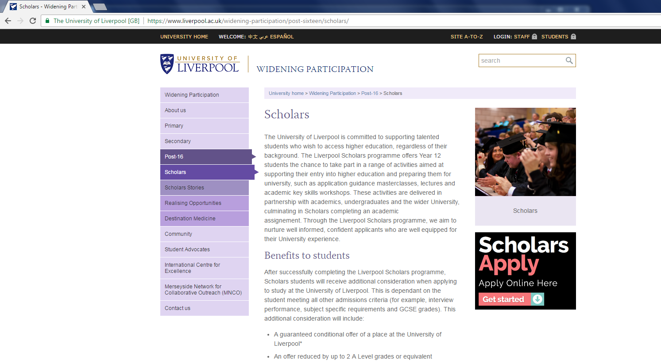
Applications open now

Slide 13
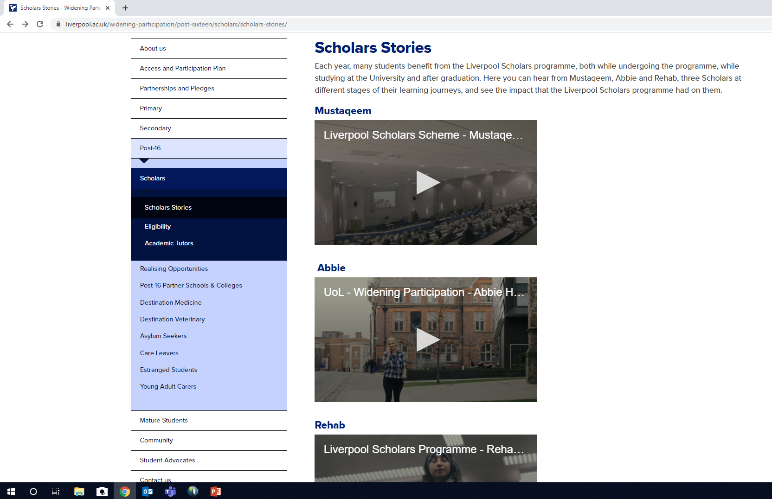
https://www.liverpool.ac.uk/widening-participation/post-sixteen/scholars/scholars-stories/

Slide 14


